Slide 1
Process Management & Organizational Effectiveness
Dorie Blackwood B.A., M.B.A.

Slide 2
Topics:
Organisational Effectiveness
Process Management
Management Control
Quality Assurance

Slide 3
Outcomes
After completing this module, participants will be able to:
Define effective organizations using effectiveness criteria models
Discuss the importance of business process management
Differentiate among different types of business controls
Discuss the implications of quality standards on business and government entities

Slide 4
How do you recognize an effective organization?
What criteria define effectiveness?

Slide 5
Effectiveness Criteria
Goal Attainment
Use of Resources
Owner Satisfaction
Adaptive to Environmental changes
Development/ Growth of company and members
Survival in the long run
Sensitivity to the needs of the community
Summary of the characteristics of an effective organization

Slide 6
Constituents Model
Constituents | Needs
Owners | ROI, growth in earnings, profitability
Employees | Good pay, fringe benefits, job satisfaction, empowerment, and growth opportunities
Customers | Fair price, quality products and services, and convenience
Suppliers | Prompt payment, future sales, and compatibility
Creditors | On-time debt settlement
Unions | Competitive wages, good working conditions, fairness in negotiations, respect, and collaboration
Community | Environmental sensitivity, right fit, benefits – good corporate citizen
Government | Compliance with laws and regulations, avoidance of penalties, and moral behaviour

Slide 7
Factors contributing to effectiveness
Organizational Design – goals, mission, structure - reporting relationships, grouped activities
Culture – distinct characteristics, brand, who you are;
Leadership - vision, direction, guidance, style
Talent Management - attract, select, develop staff
Systems and Processes - tools, the way things get done, risk management

Slide 8
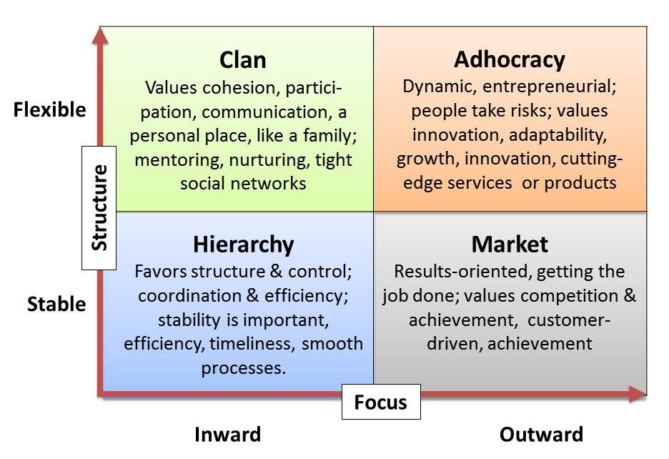
Organization Culture – Quinn & Cameron University of Michigan

Slide 9
The Contradictions Model: Assumptions:
Organizations operate in complex environments that place demands and constraints on them;
Organizations have multiple, conflicting goals;
Organizations face multiple internal and external stakeholders that make competing and conflicting demands on them
Organizations must manage multiple and conflicting time demands (short, medium and long term)

Slide 10
Dimensions of Effectiveness
Flexibility
Human Resources Staff development and growth Staff morale and engagement Cohesion and teamwork Organizational Health | Open System Acquisition of resources Good relationships with external stakeholders Good corporate citizen
Internal Process Company structure Stability/ agility Effective communication, IT management, decision making, process management | Rational Goal Mission, Vision, Values, Culture Planning and goal setting Productivity, efficiency, profit Output / outcome goals
Internal
External
Control

Slide 11
Business Process
Definition:
A business process can be anything from processing a customer’s order, opening a new account, to on-boarding a new employee. It is the set of steps taken in day to day work activities performed to accomplish a desired outcome.

Slide 12
Types of Business Processes
There are different levels or types of business processes. Types of processes referred to here as 'Super Processes' and include management processes, operational processes and supporting processes.
Operational processes: also considered as 'core value streams' or 'primary processes', are processes that are central to the design, production and delivery of a company’s products and services.

Slide 13
Process Management
“It is the application of knowledge, tools, skills, techniques, and systems to define, visualize, measure and control, report and improve systems to meet customer requirements profitably”.
(ISO 9001 process approach to managing an organization – Wikipedia)

Slide 14
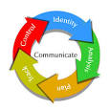
The term business process management covers how we study, identify, change, and monitor business processes, to ensure they run smoothly, and can be improved over time.

Slide 15
Organizational Effectiveness and Control
Controlling is the process whereby managers monitor and regulate how efficiently and effectively an organization and its members perform the activities necessary to achieve organizational/ business goals.

Slide 16
Purpose of Controls
Achievement of organizational goals
Organisational flexibility – adapting to change
Efficiency and effectiveness (cost and productivity)
Improve collaboration among departments
Ensure compliance with government and other legal regulations
Prevent fraud, errors, and mis-management

Slide 17
Levels of Control
Strategic Control – org. structure, leadership, technology etc
Structural Control – bureaucratic control or clan control
Operational Control – the factors of production or service delivery systems
Financial Control – processes, rules and practices that govern the use of company’s monetary resources
Responsibility for control rests with all managers throughout the organization.

Slide 18
Types of Control
Four main resources define the areas of control:
Physical Resources –
Equipment and building (audits, maintenance schedules, disaster management etc)
Human Resources -
Selection and placement (background checks, pre-employment medicals, on-boarding)
Training and development (benchmarking, performance management, LMS)
Financial Resources
Debt, cash flow. receivables, payables; financial statements;
Risk management, budget management; ratio analysis;
Inventory Management (stock taking, just-in-time systems, security,)
Operations Control (automation, feedforward, concurrent and feedback systems. Quality mgmt.)
Performance appraisal and compensation (benchmarking, merit pay, pay for performance)
Asset management, investments
Information Resources
Sales / marketing forecasting; economic forecasting ; customer surveys;
Environmental analysis (macro, micro and meso)
Public Relations; Production scheduling

Slide 19
Operations Control
Steering or feed-forward control – prior to the start of the production process
Screening or concurrent control – meeting standards during the production process
Post-action or feedback control focuses on output, after the production process is complete.

Slide 20
Class Exercise #1

Slide 21
Costs of Control
Financial costs e.g. internal and external audits;
Reduced flexibility and responsiveness (slower decision making and processing)
Inhibits innovation and creativity
Reputational risks – tarnished relationships with suppliers and creditors

Slide 22
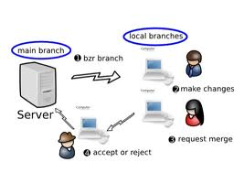
Maintaining Control
Policies and Procedures
Checks and balances
On-boarding/ probation period /immersion in culture
Review / Audits
Staff Empowerment (clan control)
Making resources and tools available
Automation
Performance Evaluations
Disciplinary Codes and Sanctions
Management Observations and Reports

Slide 23
Assessing Control Systems
Integration with planning
Flexibility – ability to accommodate change
Accuracy – provide accurate information
Timeliness – provide information as frequently as needed.

Slide 24
Quality & Quality Assurance
The terms “quality assurance” and “quality control” are often used interchangeably to refer to ways of ensuring the quality of a service or product. The terms, however, have different meanings.
Assurance: The act of giving confidence, the state of being certain or the act of making certain.

Slide 25
Quality & Quality Assurance
Quality Assurance: The planned and systematic activities implemented in a quality system so that quality requirements are guaranteed.
Control: An evaluation to indicate needed corrective responses; the act of guiding a process in which variability is attributable to a constant system of chance causes.
Quality Control: The evaluation techniques and activities used to fulfill requirements for quality.
(The American Society for Quality)

Slide 26
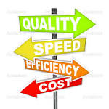
Setting Quality Standards
Standards are the specifications for product manufacture or service delivery which can be measured and are usually documented.
(e.g. Service Level Agreements, Customer Charter)
Customer defined (existing, potential and lost customers)
Legislative requirements (Bureau of Standards)
Management (Mission, strategic commitments)
Employees (process review, reports)
Competitors – locally and overseas

Slide 27
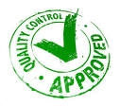
Measuring Quality
Organizational audits against goals (top-down)
Peer review and Benchmarking (horizontal: associated with Best Practices; competitive analysis)
Certifications and accreditations (external)
Customer satisfaction ratings against company expectations (bottom-up)

Slide 28
Maintaining Quality
Proactive Approach
Environmental scanning
Innovation
Staff training
Gap analysis
Surveys
Reactive Approach
Complaints system
Performance indices

Slide 29
Understanding International Quality
International quality standards are criteria or rules set up by organizations that help determine compliance across national borders.
International standards center around issues such as the rules of measurement units, use of symbols or how to define a process to meet quality control.

Slide 30
Understanding International Quality
The most influential group that monitors global standards is the International Organization for Standardization (ISO). The ISO helps define consensus among participating groups, such as national standards institutes from over 160 counties and various industry associations.
Standards are set for different industries e.g. health, manufacturing, automobile, aviation etc. and centre around consumer protection, environmental issues, and legislations.

Slide 31
Why International Quality Standards?
Global economy (world markets)
Deregulation
Establish comparative and competitive analysis / advantages
Facilitate outsourcing - standardization
Movement of factors of production (including labour)
Utilization of information and communication technology

Slide 32
International standards Advantages
Product or service consistency / dependability
Safer and higher quality for everyone
Easier adoption of products to new markets
Lower developmental costs
Satisfaction of market demands
Product and service portability
Increased customer choice, and market competition

Slide 33
International Service Standards (CSIA)
Reduce cost and improve revenue generation
Attract aid – health, research, emergency services
Foster international collaboration and partnerships
Facilitate licensing and certification
Boost country and government reputation
Meet customer expectations e.g. tourism

Slide 34
International Products & Process Standards
International Organization for Standardization (ISO)
International Electro-technical Commission (IEC)
International Telecommunication Union (ITU),
Developers of technical standards are generally concerned with interface standards, which detail how products interconnect with each other, and safety standards with established characteristics, which ensure that a product or process is safe for humans, animals, and the environment. The subject of their work can be narrow or broad. Another area of interest is in defining how the behavior and performance of products are measured and described in data sheets.

Slide 35
Class Exercise #2

